Slide 1
Financial Forecast Update
October 27, 2026

Slide 2
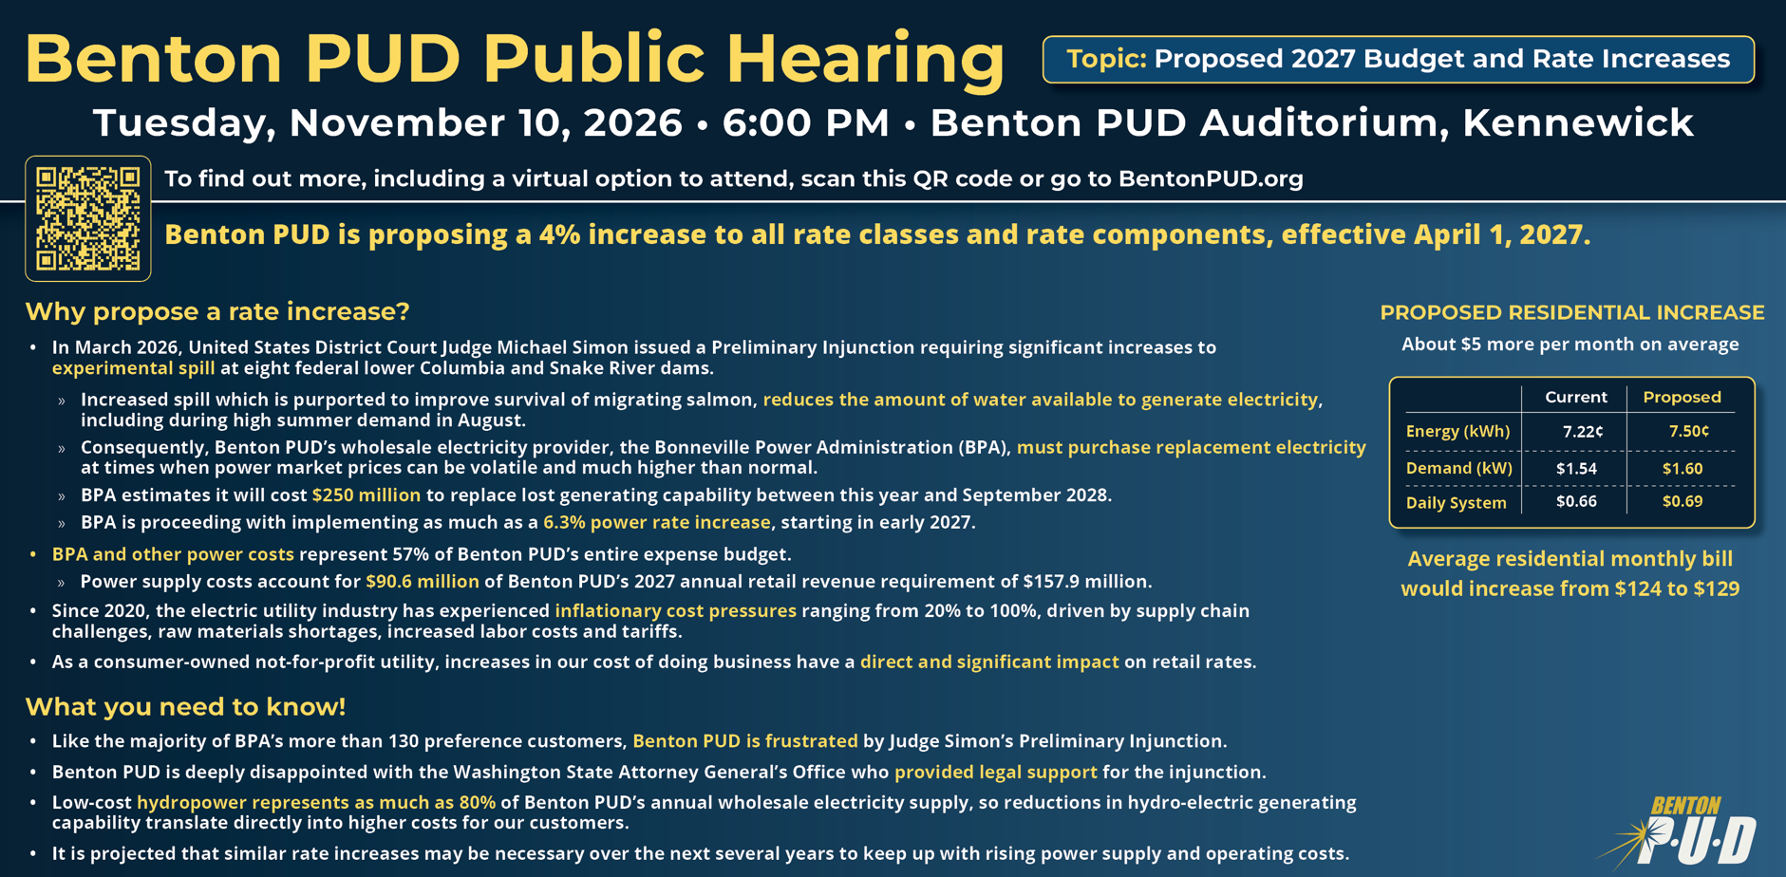
2

Slide 3
Agenda
Previous Forecast
Forecast Update & Results
Questions

Slide 4
September 2026 Forecast Scenario 1
With estimated Preliminary Injunction impacts**
BPA Assumptions:
BP-26: 9% Power & 20% Transmission
BP-29: 7% Power & 15% Transmission
BP-31: 5% Power & 10% Transmission
Description |  | 2025 Actual | 2026 | 2027 | 2028 | 2029 | 2030
Sept 2026 | Projected Rate Increase* | Apr 1 5.0% | Apr 1 2.0% | Apr 1 4.0% | Apr 1 4.0% | Apr 1 4.0% | -
 | Unrestricted DCOH | 143 | 161 | 129 | 109 | 110 | 104
 | Construction Account DCOH | - | 27 | - | - | - | -
 | Net Income | $15.0M | $8.3M | $4.5M | $9.8M | $13.5M | $16.0M
 | Total Unrestricted Reserves | $49.4M | $58.8M | $50.0M | $42.7M | $44.1M | $42.4M
 | Construction Account Reserves | - | $10.0M | - | - | - | -
 | Debt to Capitalization (38% Max) | 26% | 32% | 31% | 29% | 27% | 24%
 | Average Residential Monthly Bill | $121 | $124 | $129 | $135 | $140 | $140
*Average overall rate increase for the District. Rate increases may be allocated differently among rate classes. Rate increase percentages and effective dates require explicit commission approval by resolution prior to implementation. Customer impacts will depend on demand patterns and overall energy use.
**$125M Surcharge (2027 – 2028) & $85M Surcharge (2029 – 2030)
$32M Bond issue in 2026

Slide 5
Financial Forecast Update

Slide 6
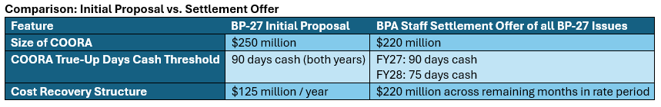
BP-27 Update
Forecast Includes BP-27 Initial Proposal
Notes:
Draft Capital Increases by category:
Transmission: $2.0M
Distribution: $6.0M
General Plant: $2.1M
IT: $1.5M
CIAC: $3.2M increase in contributions
NPC reductions include:
Updated Transmission estimate: $5.1M
Preliminary Injunction estimate reduction: $1.3M
Updated TEA fees: $0.6M
Updated forward price curves: $0.5M

Slide 7

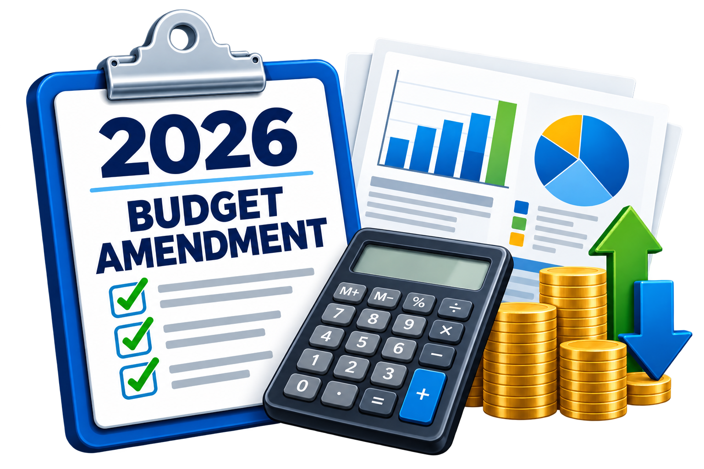
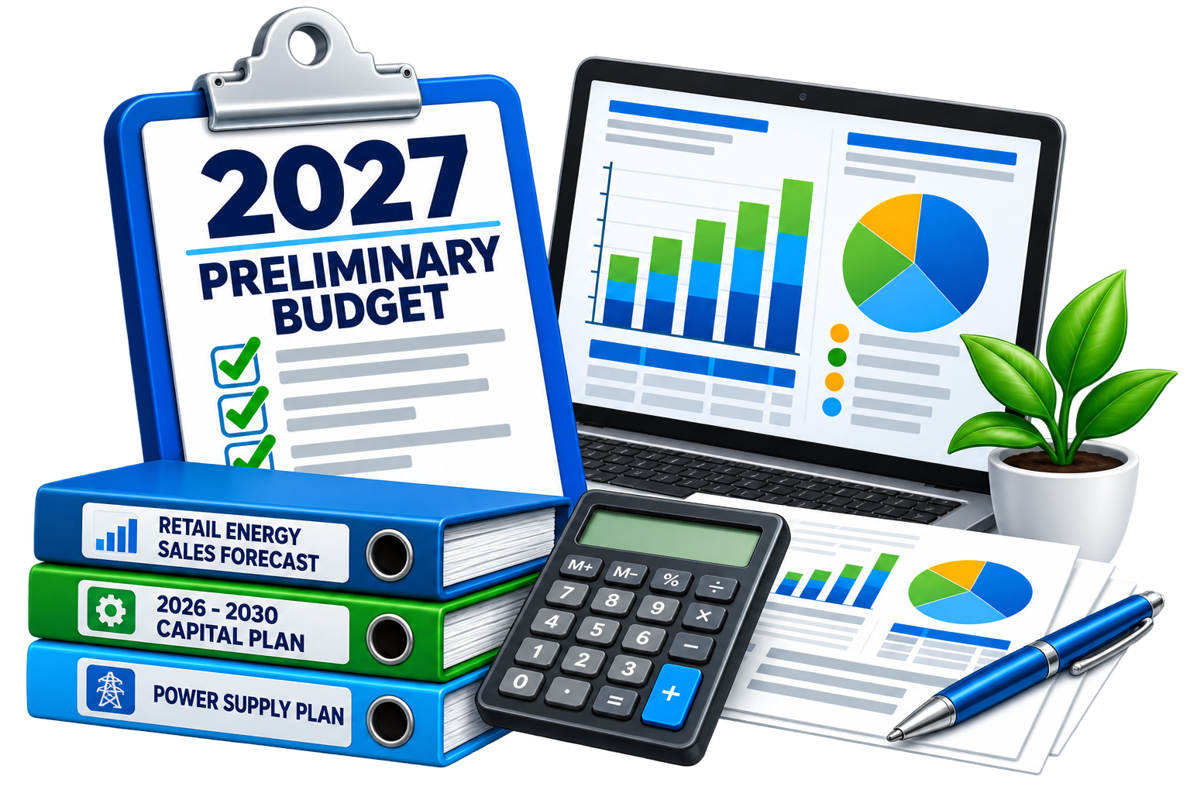
Forecast Updates
2026 Actuals YTD
Retail Sales & NPC
2026
Budget Amendment
2027
Preliminary Budget
Notes:
Draft Capital Increases by category:
Transmission: $2.0M
Distribution: $6.0M
General Plant: $2.1M
IT: $1.5M
CIAC: $3.2M increase in contributions
NPC reductions include:
Updated Transmission estimate: $5.1M
Preliminary Injunction estimate reduction: $1.3M
Updated TEA fees: $0.6M
Updated forward price curves: $0.5M

Slide 8
October 2026 Forecast Scenario
With estimated Preliminary Injunction impacts**
BPA Assumptions:
BP-26: 9% Power & 20% Transmission
BP-29: 7% Power & 15% Transmission
BP-31: 5% Power & 10% Transmission
Description |  | 2025 Actual | 2026 | 2027 | 2028 | 2029 | 2030
Oct 2026 | Projected Rate Increase* | Apr 1 5.0% | Apr 1 2.0% | Apr 1 4.0% | Apr 1 4.0% | Apr 1 4.0% | -
 | Unrestricted DCOH | 143 | 167 | 127 | 107 | 108 | 101
 | Construction Account DCOH | - | 27 | - | - | - | -
 | Net Income | $15.0M | $10.3M | $3.3M | $8.8M | $12.7M | $14.9M
 | Total Unrestricted Reserves | $49.4M | $60.4M | $49.8M | $42.2M | $43.2M | $41.2M
 | Construction Account Reserves | - | $10.0M | - | - | - | -
 | Debt to Capitalization (38% Max) | 26% | 32% | 31% | 29% | 27% | 25%
 | Average Residential Monthly Bill | $121 | $124 | $129 | $135 | $140 | $140
*Average overall rate increase for the District. Rate increases may be allocated differently among rate classes. Rate increase percentages and effective dates require explicit commission approval by resolution prior to implementation. Customer impacts will depend on demand patterns and overall energy use.
**$125M Surcharge (2027 – 2028) & $85M Surcharge (2029 – 2030)
$32M Bond issue in 2026

Slide 9
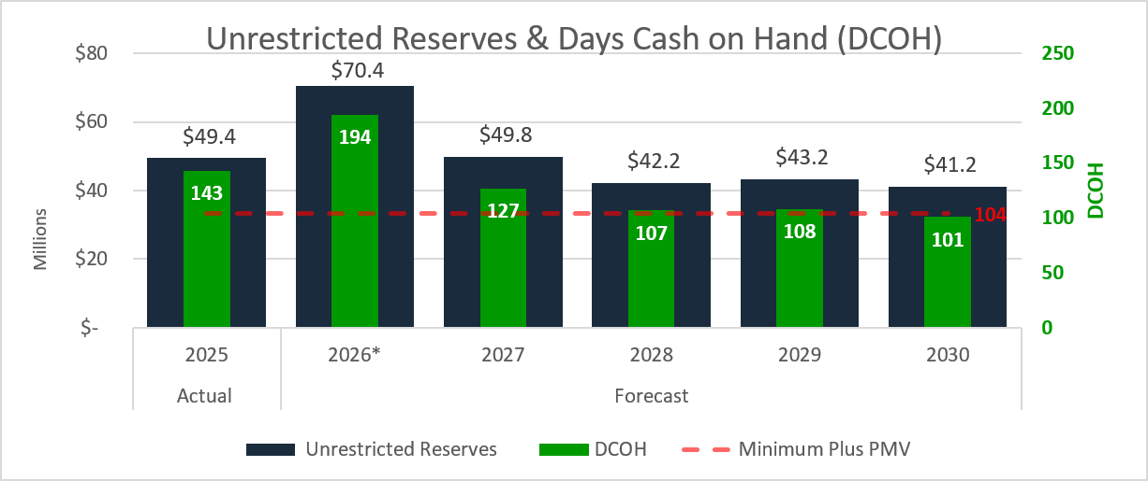
October 2026 Forecast Scenario
*$32M Bond Issue in Q4 of 2026
BPA Assumptions:
BP-26: 9% Power & 20% Transmission
BP-29: 7% Power & 15% Transmission
BP-31: 5% Power & 10% Transmission

Slide 10

Average Residential Rate Comparison
Source: U.S. Energy Information Administration
Notes:
Q2 2026 Benton rate was calculated from the 2026-06 Combined file Yearly tab total Residential Revenue / total Residential Usage

Slide 11
QUESTIONS?

Slide 12
June 2026 Forecast Scenario 2
With estimated Preliminary Injunction impacts**
BPA Assumptions:
BP-26: 9% Power & 20% Transmission
BP-29: 7% Power & 15% Transmission
BP-31: 5% Power & 10% Transmission
Description |  | 2025 Actual | 2026 | 2027 | 2028 | 2029 | 2030
Jun 2026 | Projected Rate Increase* | Apr 1 5.0% | Apr 1 2.0% | Apr 1 6.0% | Apr 1 2.5% | Apr 1 2.5% | -
 | Unrestricted DCOH | 143 | 116 | 137 | 124 | 115 | 103
 | Construction Account DCOH | - | 59 | - | - | - | -
 | Net Income | $15.0M | $6.3M | $5.0M | $9.1M | $11.0M | $9.5M
 | Total Unrestricted Reserves | $49.4M | $42.2M | $53.7M | $49.1M | $46.4M | $42.4M
 | Construction Account Reserves | - | $22.2M | - | - | - | -
 | Debt to Capitalization (38% Max) | 26% | 32% | 31% | 29% | 27% | 25%
 | Average Residential Monthly Bill | $121 | $124 | $132 | $135 | $139 | $139
*Average overall rate increase for the District. Rate increases may be allocated differently among rate classes. Rate increase percentages and effective dates require explicit commission approval by resolution prior to implementation. Customer impacts will depend on demand patterns and overall energy use.
**$125M Surcharge (2027 – 2028) & $85M Surcharge (2029 – 2030)
$32M Bond issue in 2026
Notes:
Note: if the Commission wants the rate increase spread evenly, then it would be 3.4% rate increases for 2027 – 2029 and we would end 2030 at 104 DCOH/

Slide 13
September 2026 Forecast Scenario 2
With estimated Preliminary Injunction impacts**
BPA Assumptions:
BP-26: 9% Power & 20% Transmission
BP-29: 7% Power & 15% Transmission
BP-31: 5% Power & 10% Transmission
Description |  | 2025 Actual | 2026 | 2027 | 2028 | 2029 | 2030
Sept 2026 | Projected Rate Increase* | Apr 1 5.0% | Apr 1 2.0% | Apr 1 6.0% | Apr 1 2.5% | Apr 1 2.5% | -
 | Unrestricted DCOH | 143 | 161 | 134 | 117 | 117 | 107
 | Construction Account DCOH | - | 27 | - | - | - | -
 | Net Income | $15.0M | $8.3M | $6.5M | $11.0M | $12.7M | $14.7M
 | Total Unrestricted Reserves | $49.4M | $58.8M | $52.0M | $45.9M | $46.5M | $43.5M
 | Construction Account Reserves | - | $10.0M | - | - | - | -
 | Debt to Capitalization (38% Max) | 26% | 32% | 30% | 28% | 26% | 24%
 | Average Residential Monthly Bill | $121 | $124 | $132 | $135 | $139 | $139
*Average overall rate increase for the District. Rate increases may be allocated differently among rate classes. Rate increase percentages and effective dates require explicit commission approval by resolution prior to implementation. Customer impacts will depend on demand patterns and overall energy use.
**$125M FRP Surcharge (2027 – 2028) & $85M FRP Surcharge (2029 – 2030)
$32M Bond issue in 2026
Notes:
Note: if the Commission wants the rate increase spread evenly, then it would be 4.0% rate increases for 2027 – 2029 and we would end 2030 at 104 DCOH/

Slide 14
September 2026 Forecast
Without estimated Preliminary Injunction impacts
BPA Assumptions:
BP-26: 9% Power & 20% Transmission
BP-29: 7% Power & 15% Transmission
BP-31: 5% Power & 10% Transmission
Description |  | 2025 Actual | 2026 | 2027 | 2028 | 2029 | 2030
Sept 2026 | Projected Rate Increase* | Apr 1 5.0% | Apr 1 2.0% | Apr 1 2.5% | Apr 1 2.5% | Apr 1 2.5% | -
 | Unrestricted DCOH | 143 | 161 | 140 | 123 | 116 | 102
 | Construction Account DCOH | - | 27 | - | - | - | -
 | Net Income | $15.0M | $8.3M | $7.3M | $10.7M | $10.9M | $12.9M
 | Total Unrestricted Reserves | $49.4M | $58.8M | $52.8M | $46.4M | $45.2M | $40.4M
 | Construction Account Reserves | - | $10.0M | - | - | - | -
 | Debt to Capitalization (38% Max) | 26% | 32% | 30% | 28% | 27% | 25%
 | Average Residential Monthly Bill | $121 | $124 | $128 | $131 | $134 | $134
*Average overall rate increase for the District. Rate increases may be allocated differently among rate classes. Rate increase percentages and effective dates require explicit commission approval by resolution prior to implementation. Customer impacts will depend on demand patterns and overall energy use.
$32M Bond issue in 2026

Slide 15
2027 Rate Increase – Commission Direction
Develop Draft Rates
September
Customer Communication
October/November
Customer
Meeting
November 10, 2026
During Budget Hearing*
Commission Approval
December 8, 2026
With Budget Adoption
Decision 1: Rate Allocation – Who pays?
Apply the same % increase to all classes?
OR
Vary increases by class to move toward COSA targets
Decision 2: Rate Design – Where is it Collected?
Spread the increases evenly across all rate components
OR
Target specific components (customer, demand, energy)?
Staff will use Commission direction to develop the preliminary 2027 rate schedules to be presented to the Commission at a later date
*This format provided a more structured meeting process, clear public-comment procedures, and efficient use of Commission and customer time.
Notes:
Rate Allocation:
Uniform
COSA-Based
Rate Design:
Proportional
Targeted

Slide 16
2026 Bond Issuance Draft Schedule

Slide 17
2026 Bond Issuance Draft Schedule*
*Dates subject to change
Apr
May
Jun
Jul
Aug
Sep
Oct
Nov
Dec
Underwriter Selection
Jun 18 – Jul 22
Official Statement
Jul 24 – Oct 7
Rating Agencies
Aug 6 – Sep 16
Bond Resolution
Sep 8
Bond Pricing
Sep 30
Bond Closing
Oct 21
Staff / Advisors Tasks
Commission Actions

Slide 18




Preliminary Injunction Order (Judge Simon’s Ruling)
Increased Spill
Seasonal Spill Expanded
2025 Reservoir Levels
Maintained
Prioritized Endangered Species Act over
Power Concerns
Temporary Measures Pending Final Decision
Notes:
PPC is working with Energy GPS to study the impacts so any numbers are very preliminary.
Spill is required 24 hours per day for much of the months, including throughout August. The previously negotiated flexible spill to optimize power production for 8 hours and spilling to gas caps (TDG) for 16 hours is no longer in play.
Reservoir pool levels will be at Minimum Irrigation Pool versus Minimum Operating Pool which is definitely a win for our irrigators. There are still some impacts in terms of maintenance of water intakes for some customers.
BPA has estimated the cost impacts to be as high as $140 million per year. Some estimates are as low as $100 million.
There are grid reliability implications when constant spill is mandated as it will be difficult to hold enough reserves when all of the water is going over the spillway and not available to keep water in the penstocks for backup generation.
Wholesale cost impacts on Benton PUD could result in a retail rate increase in the ballpark of 2.5% to 3.5% beginning with FY27, i.e. starting October 1st of this year.
Since BPA will be forced to by replacement power from the market Benton PUD could also face an FRP surcharge later this year depending on how high market prices get, particularly in the late summer months.
Federal Agencies will appeal but this could take 2 or 3 years to resolve.
It definitely could have been much worse but PPC was allowed as an intervenor to actually provide the judge with suggested compromises. This is highly unusual as intervenors are more often left on the sideline.
The final outcome down the road could definitely be worse if the judge orders multi-billion dollar infrastructure improvements.

Slide 19
Benton PUD - Low Retail Rates
19
Source: U.S. Energy Information Administration
Notes:
Benton PUD Q1 2026 reflects current rates including the rate increase that was implemented April 1, 2026.

Slide 20
2027 Rate Increase

Slide 21
2027 Rate Increase – Process/Timeline
Develop Draft Rates
September
Customer Communication
October/November
Customer
Meeting
November 10, 2026
During Budget Hearing*
Commission Approval
December 8, 2026
With Budget Adoption
*This format provided a more structured meeting process, clear public-comment procedures, and efficient use of Commission and customer time.
Notes:
Prior to 2020, budget public hearings were held at night.

Slide 22
2026 vs 2025 COSA Results Comparison to Target
(Incorporating the strategic use of reserves)
0.0%
2.0%
10.0%
2.5%
2.1%
3.0%
Applying rate increases uniformly will not resolve COSA misalignment
*Using 2026 load forecast and 2026 rates.
Notes:
The reason security lighting jumped so much was due to cost allocation was reduced in 2026 versus 2025. The percentage from the Trial Balance for Maintenance of Yard lights was less so less costs were assigned.
COSA versus Estimated Retail Sales
2% Increase = ~$2.8M
Reserves were allocated based on estimated retail revenue received from each class

Slide 23
2027 Rate Increase – New Power Cost Driver
Court-Ordered Operations Rate Adjustment (COORA) – New BPA power cost associated with hydro system operations
2.46 mills/kWh*
What is Changing? | How is it Charged? | Rate Allocation Implication
Additional BPA power cost | 2.46 mills/kWh | Applies across customer energy usage
Driven by court-ordered hydro operations | Usage-based wholesale cost | Supports allocating the increase across all rate classes
Staff Perspective: Because the COORA is a usage-based power cost that affects all customer rate classes,
staff recommends recovering the associated revenue requirement across all rate classes.
COORA Equivalent: ~ $3.20/month for an average residential customer (based on 1,300 kWh/month)
*Based on BPA’s published draft COORA rate schedule
Notes:
Because the BP027 rate case is $2.46 mills/kWh, it only makes sense all customer classes should pay.
Rate Allocation:
Uniform
COSA-Based
Rate Design:
Proportional
Targeted

Slide 24
2026 vs 2025 COSA Results Comparison to Target
(Incorporating the strategic use of reserves | Includes $4.3M estimated impact from Preliminary Injunction)
Cost causation supports allocating the COORA-related rate increase uniformly across all rate classes.
*Using 2026 load forecast and 2026 rates.
Notes:
The reason security lighting jumped so much was due to cost allocation was reduced in 2026 versus 2025. The percentage from the Trial Balance for Maintenance of Yard lights was less so less costs were assigned.
COSA versus Estimated Retail Sales
2% Increase = ~$2.8M
Reserves were allocated based on estimated retail revenue received from each class

Slide 25
2027 Rate Increase – Commission Direction
Develop Draft Rates
September
Customer Communication
October/November
Customer
Meeting
November 10, 2026
During Budget Hearing*
Commission Approval
December 8, 2026
With Budget Adoption
Decision 1: Rate Allocation – Who pays?
Staff Recommendation: Cost Causation
Apply the same % increase to all classes?
Decision 2: Rate Design – Where is it Collected?
Staff Recommendation: Gradualism
Spread the increases evenly across all rate components
Staff will use Commission direction to develop the preliminary 2027 rate schedules to be presented to the Commission at a later date
*This format provided a more structured meeting process, clear public-comment procedures, and efficient use of Commission and customer time.
Notes:
Because the BP027 rate case is $2.46 mills/kWh, it only makes sense all customer classes should pay.
Rate Allocation:
Uniform
COSA-Based
Rate Design:
Proportional
Targeted

Slide 26
Estimated Preliminary Injunction Impacts
Delete? Since we have gone over this multiple times?
BP-26
FY2026
FY2027
FY2028
Costs
$85M
$85M
$85M
= $255M
Rates
$125M
$125M
= $250M
Benton PUD Impact
Rates
(2027 – 2028 Immediate Impact)
Costs
(Annual Impact Beyond FY2028)
~$4.3M per Year
~$3.0M per Year
$4.3M ÷ $140M = 3.1%
$3.0M ÷ $140M = 2.1%
Notes:
PPC is working with Energy GPS to study the impacts so any numbers are very preliminary.
Spill is required 24 hours per day for much of the months, including throughout August. The previously negotiated flexible spill to optimize power production for 8 hours and spilling to gas caps (TDG) for 16 hours is no longer in play.
Reservoir pool levels will be at Minimum Irrigation Pool versus Minimum Operating Pool which is definitely a win for our irrigators. There are still some impacts in terms of maintenance of water intakes for some customers.
BPA has estimated the cost impacts to be as high as $140 million per year. Some estimates are as low as $100 million.
There are grid reliability implications when constant spill is mandated as it will be difficult to hold enough reserves when all of the water is going over the spillway and not available to keep water in the penstocks for backup generation.
Wholesale cost impacts on Benton PUD could result in a retail rate increase in the ballpark of 2.5% to 3.5% beginning with FY27, i.e. starting October 1st of this year.
Since BPA will be forced to by replacement power from the market Benton PUD could also face an FRP surcharge later this year depending on how high market prices get, particularly in the late summer months.
Federal Agencies will appeal but this could take 2 or 3 years to resolve.
It definitely could have been much worse but PPC was allowed as an intervenor to actually provide the judge with suggested compromises. This is highly unusual as intervenors are more often left on the sideline.
The final outcome down the road could definitely be worse if the judge orders multi-billion dollar infrastructure improvements.

Slide 27
2026 – 2030 Gross Capital Plan
Total 5-Year Capital Plan $139.8M
Notes:
2030 has an increase in CIAC, $2.5M Chandler Substation (Distribution) offset by $2.5M CIAC
Additional capital increases is refinement of the capital plan and project estimates. Increases are attributed to cost increases due to inflation. Known increases (25% tariff increase on conductors/wires)

