Slide 1
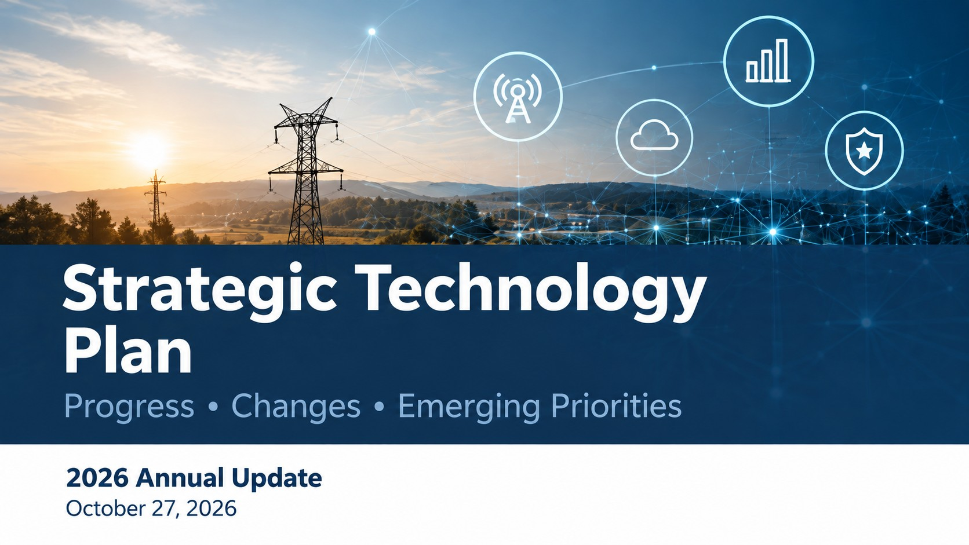

Slide 2
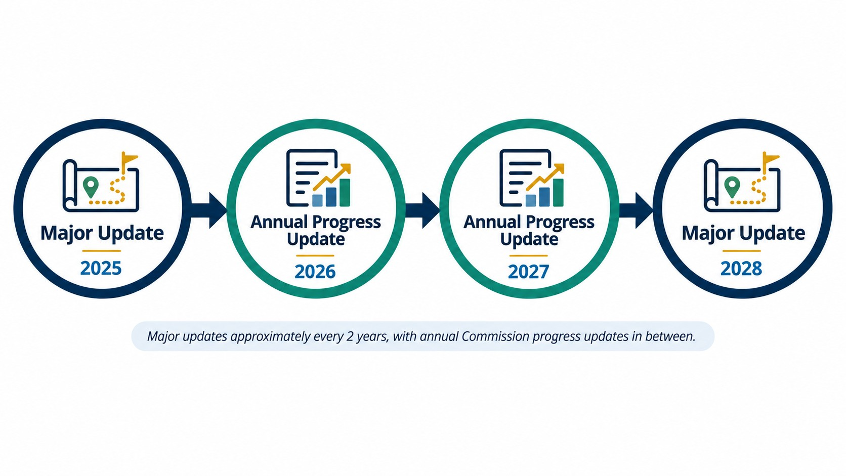
Technology Planning Process
Notes:
As you are aware our planning process consists of a major update, annual updates to the Commission thereafter. The major updates are completed about every 2 years, the last one was completed and presented to you in February 2026

Slide 3
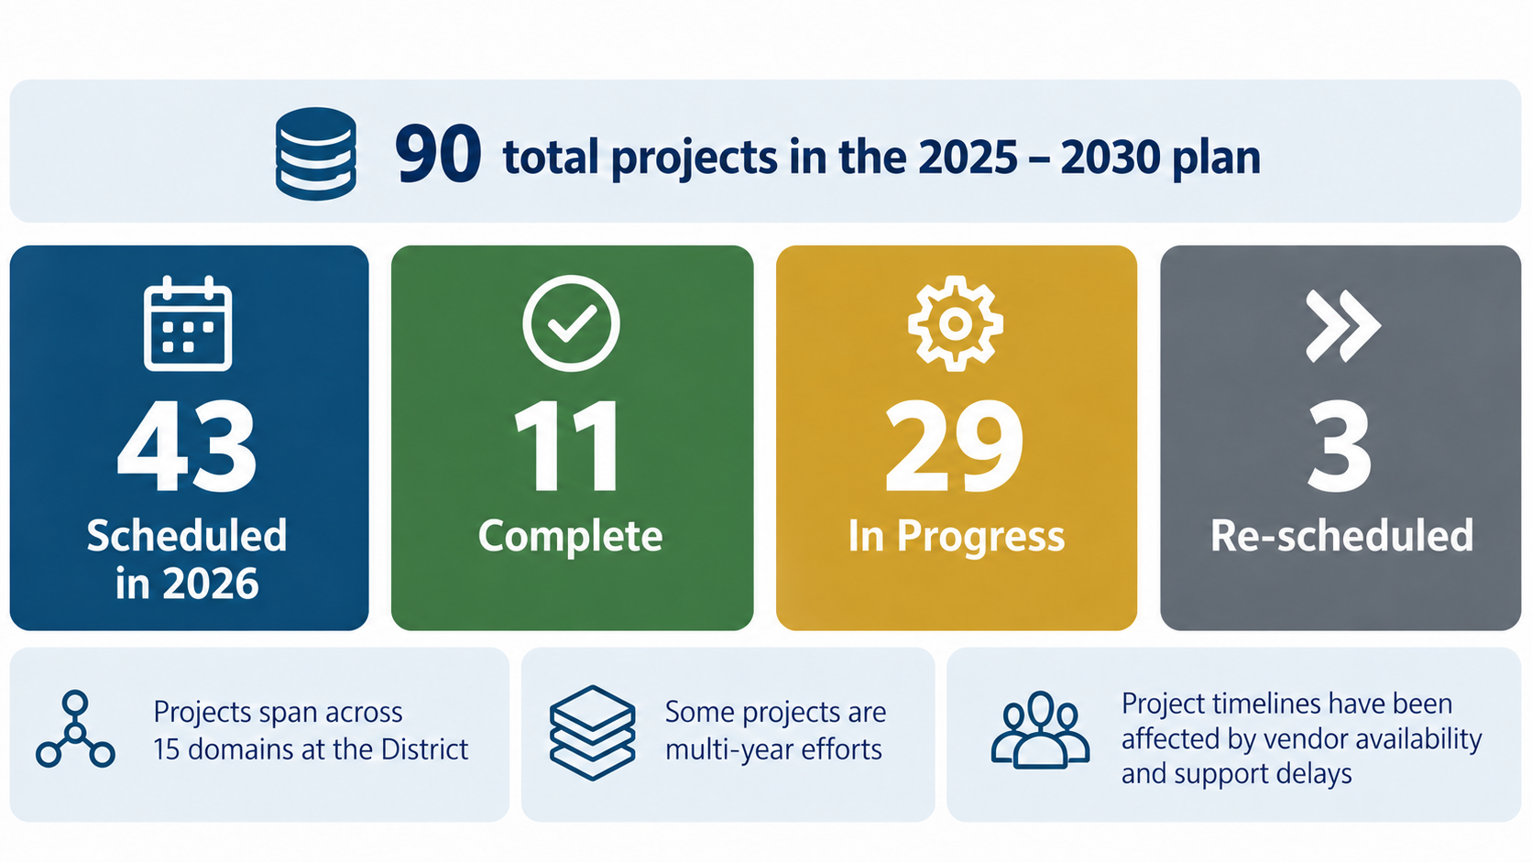
2026 By the Numbers

Slide 4
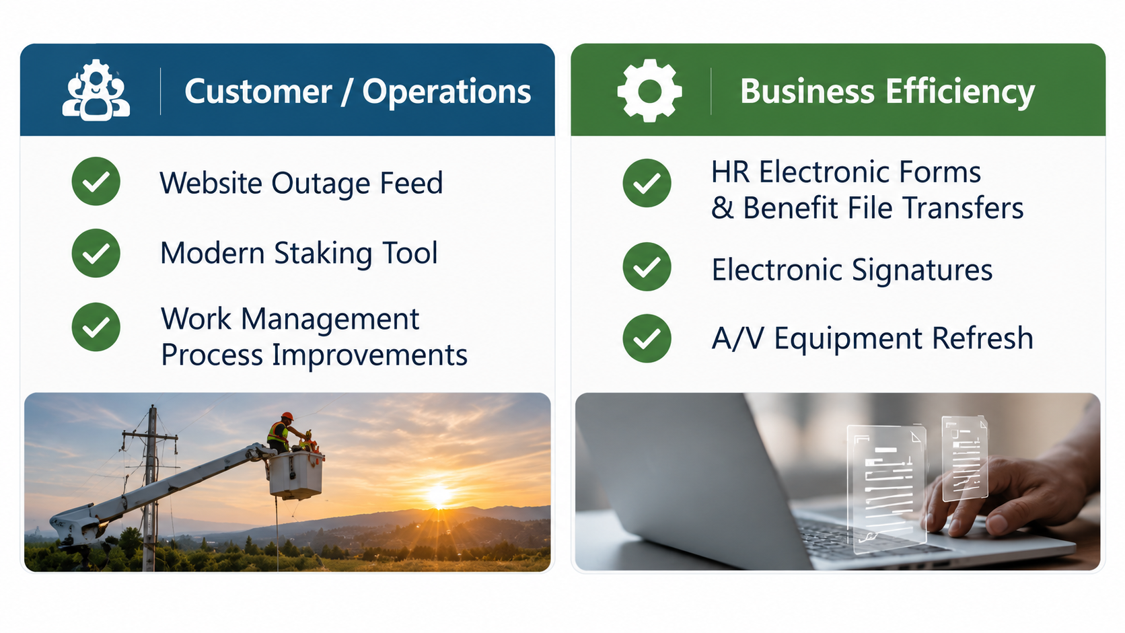
2026 Accomplishments

Slide 5
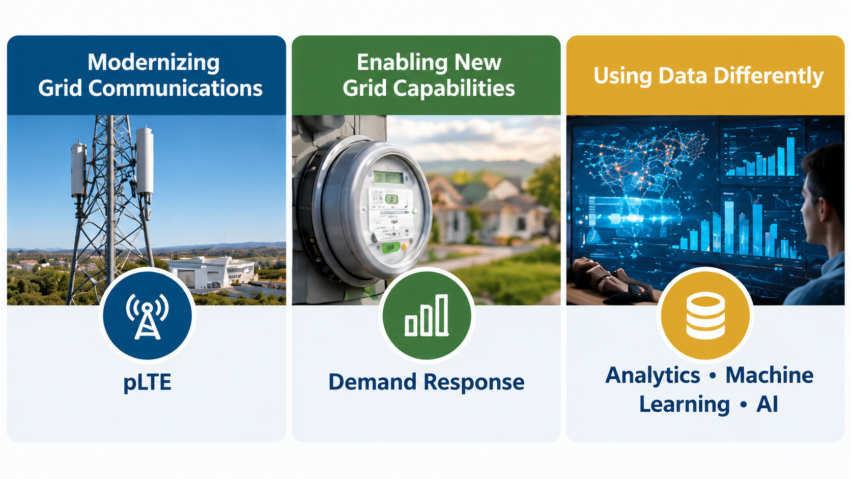
2026 Strategic Initiative Spotlights

Slide 6
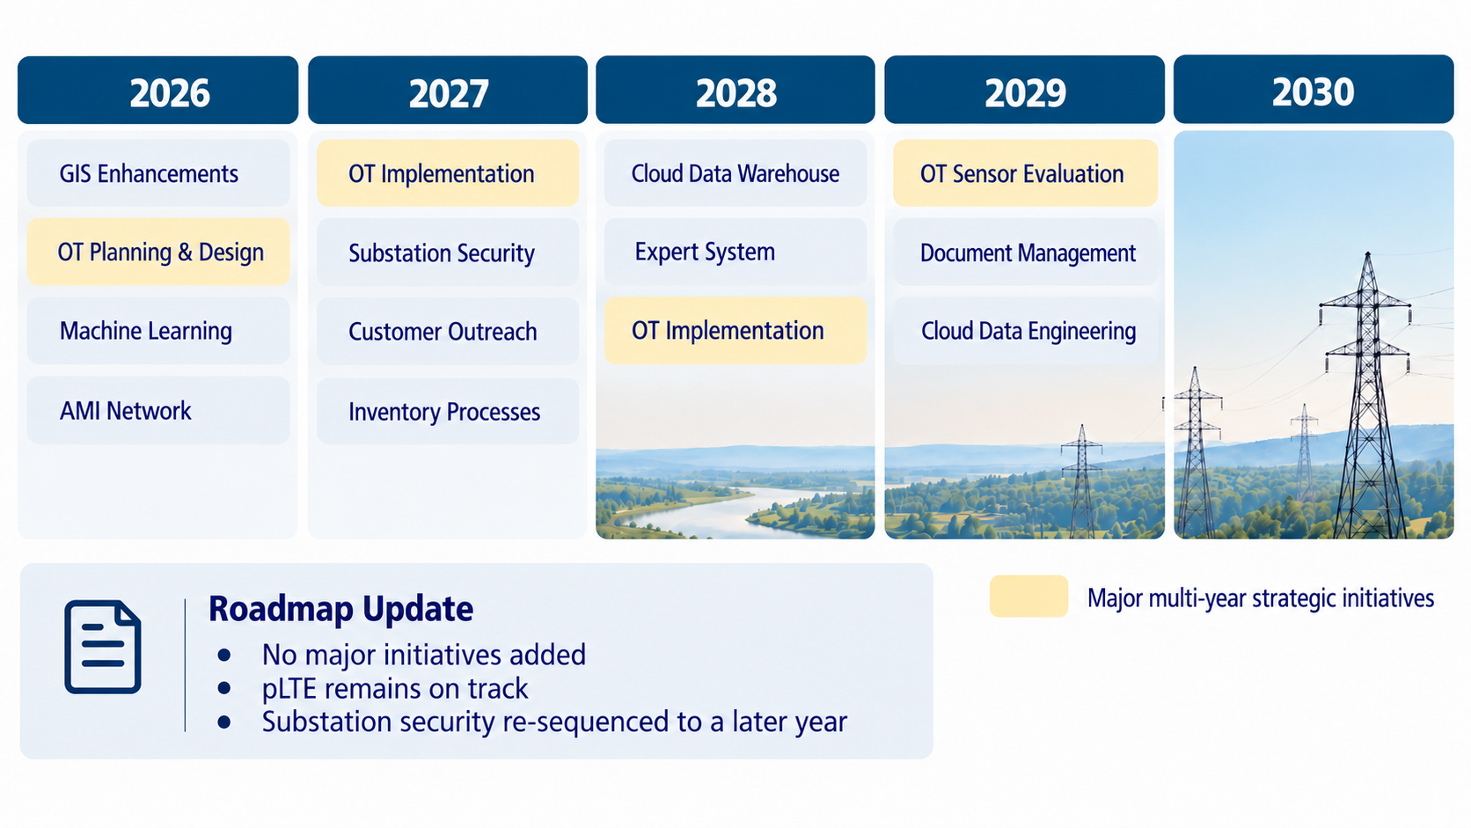
Strategic Initiatives Roadmap
GIS Enhancements
OT Planning & Design
Machine Learning
AMI Network
OT Implementation
Expert System
Cloud Data Warehouse
Document Management
OT Implementation
OT Sensor Evaluation
Cloud Data Engineering
Notes:
You will see in the upcoming budget presentations, there are no major initiatives that have been added to the plan.
The pLTE project is on track and has been included in the budget, substation security was pushed out a year, but we continued efforts to modernize the security systems around the campus. We have completed the foundational tasks to support developing a proof of concept using machine learning in the first half of 2027
We will be back in 2027 to provide an update to the Commission and will be preparing the next comprehensive plan in 2028

Slide 7
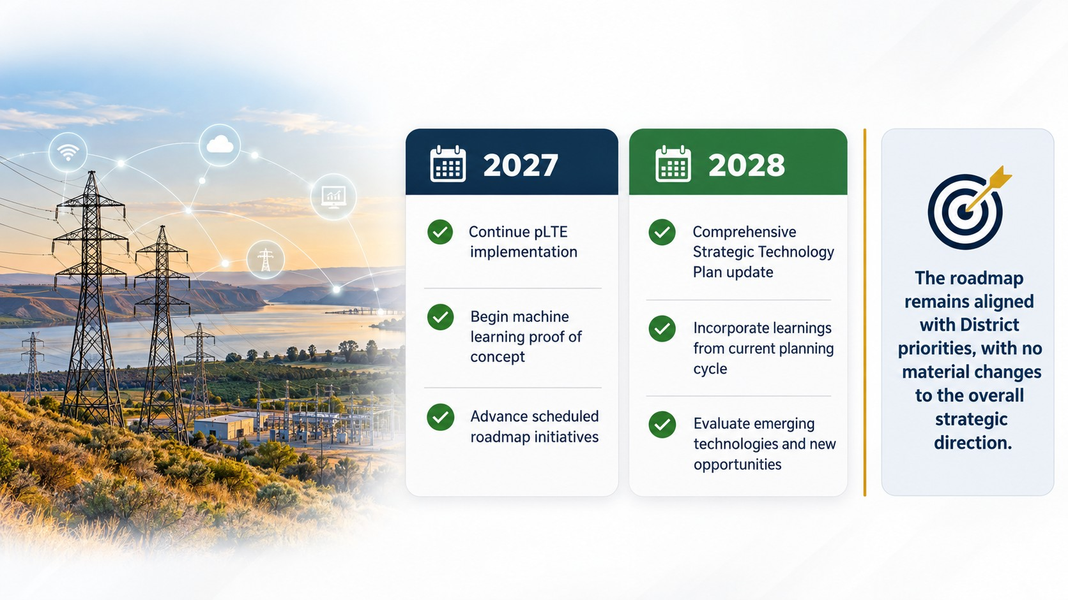
Looking Forward

