Slide 1
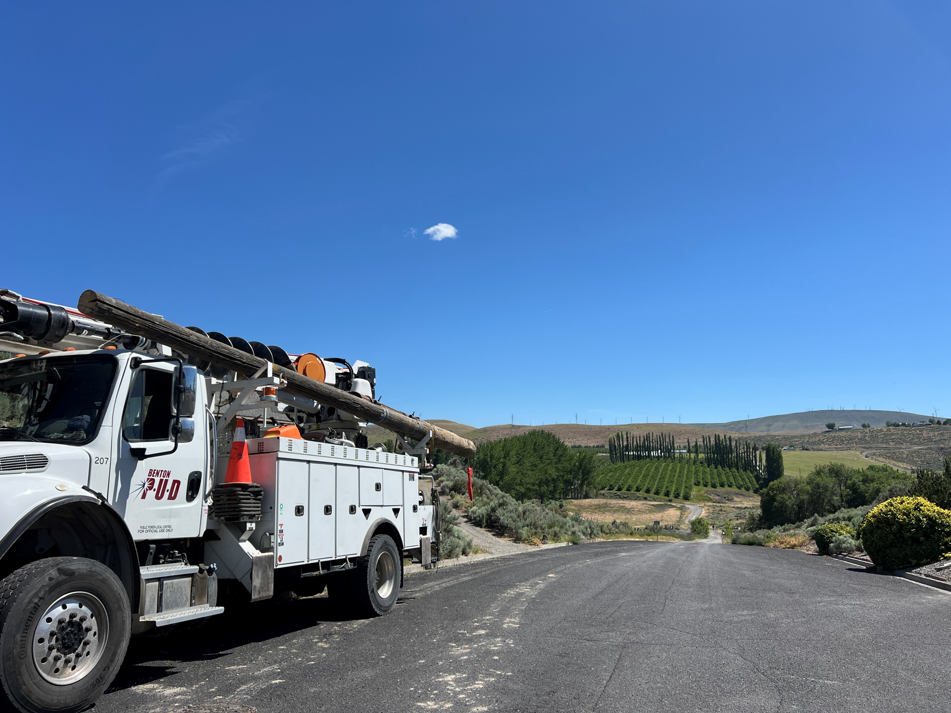

State Of Cyber Security
IT Infrastructure
October 27, 2026

Slide 2
Agenda
1
Cyber Security Trends
2
Recent Events
3
BPUD Policies
4
Internal Statistics
5
2027 and Beyond

Slide 3
Cyber Threat Landscape
Verizon 2026 Data Breach Investigations Report
Utilities Sector
597
Confirmed data
breaches
97%
Breaches involving
external threat actors
71%
Breaches involving
espionage motives
Top patterns:
System Intrusion, Basic Web Application Attacks and Social Engineering represent 94% of breaches
Data compromised:
Internal (85%), Secrets (68%),Other (21%) (breaches)
Source: Verizon's 2026 Data Breach Investigations Report

Slide 4
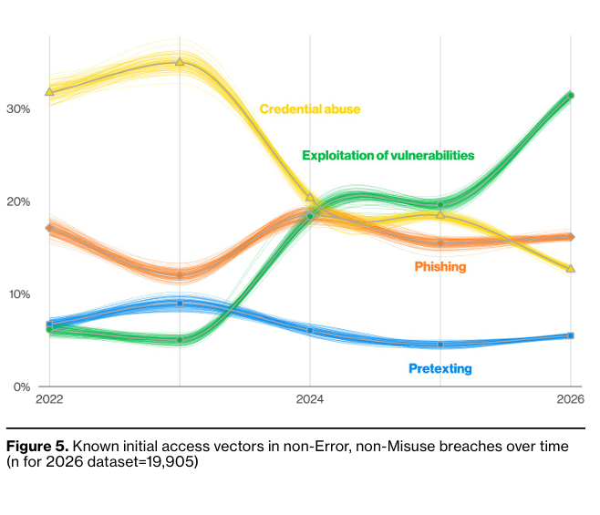
Cyber Attack Methods
Initial Access Vectors
Vulnerability exploitation has risen to 31%
Credential abuse has declined to 13%
Phishing accounts for 16%
Pretexting accounts for 6%
Percentages reflect known initial access vectors in Verizon's non-Error, non-Misuse breach dataset.
Source: Verizon 2026 Data Breach Investigations Report

Slide 5
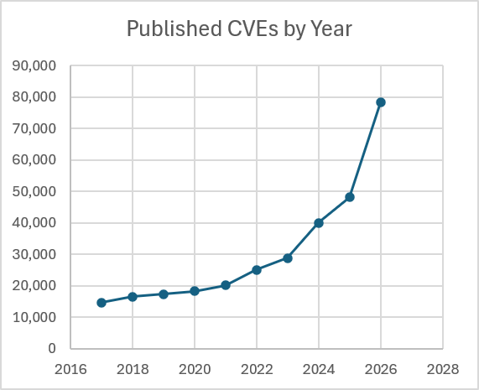
Vulnerabilities
Common Vulnerabilities and Exposures (CVE)
A CVE is a unique identifier assigned to a publicly disclosed cybersecurity vulnerability.
Increase per year
2024: +39%
2025: +21%
2026: +62%*
*2026 year-to-date through October 13, compared with full-year 2025

Slide 6

U.S. Critical Infrastructure Attacks
Iranian-Affiliated Cyber Actors
Targeted internet-connected industrial control systems
Affecting multiple U.S. critical infrastructure sectors
Manipulated PLC programming and information displayed through SCADA and human-machine interface systems.
Operational disruptions and financial losses.
Source: CISA Joint Cybersecurity Advisory AA26-097A, updated July 22, 2026.

Slide 7

CenterPoint Data Breach
CenterPoint Energy
Electric and natural gas utility, 7 million customers.
1.61 million affected individuals
PII included names, addresses, SSN, and driver's license numbers.
Service delivery remained operational and undisrupted.
The threat actor claimed to have accessed customer information through an unsecured application programming interface (API).
Sources: CenterPoint Energy 2025 Form 10-K; September 14, 2026 Form 8-K; Texas Attorney General breach notification, October 13, 2026.

Slide 8
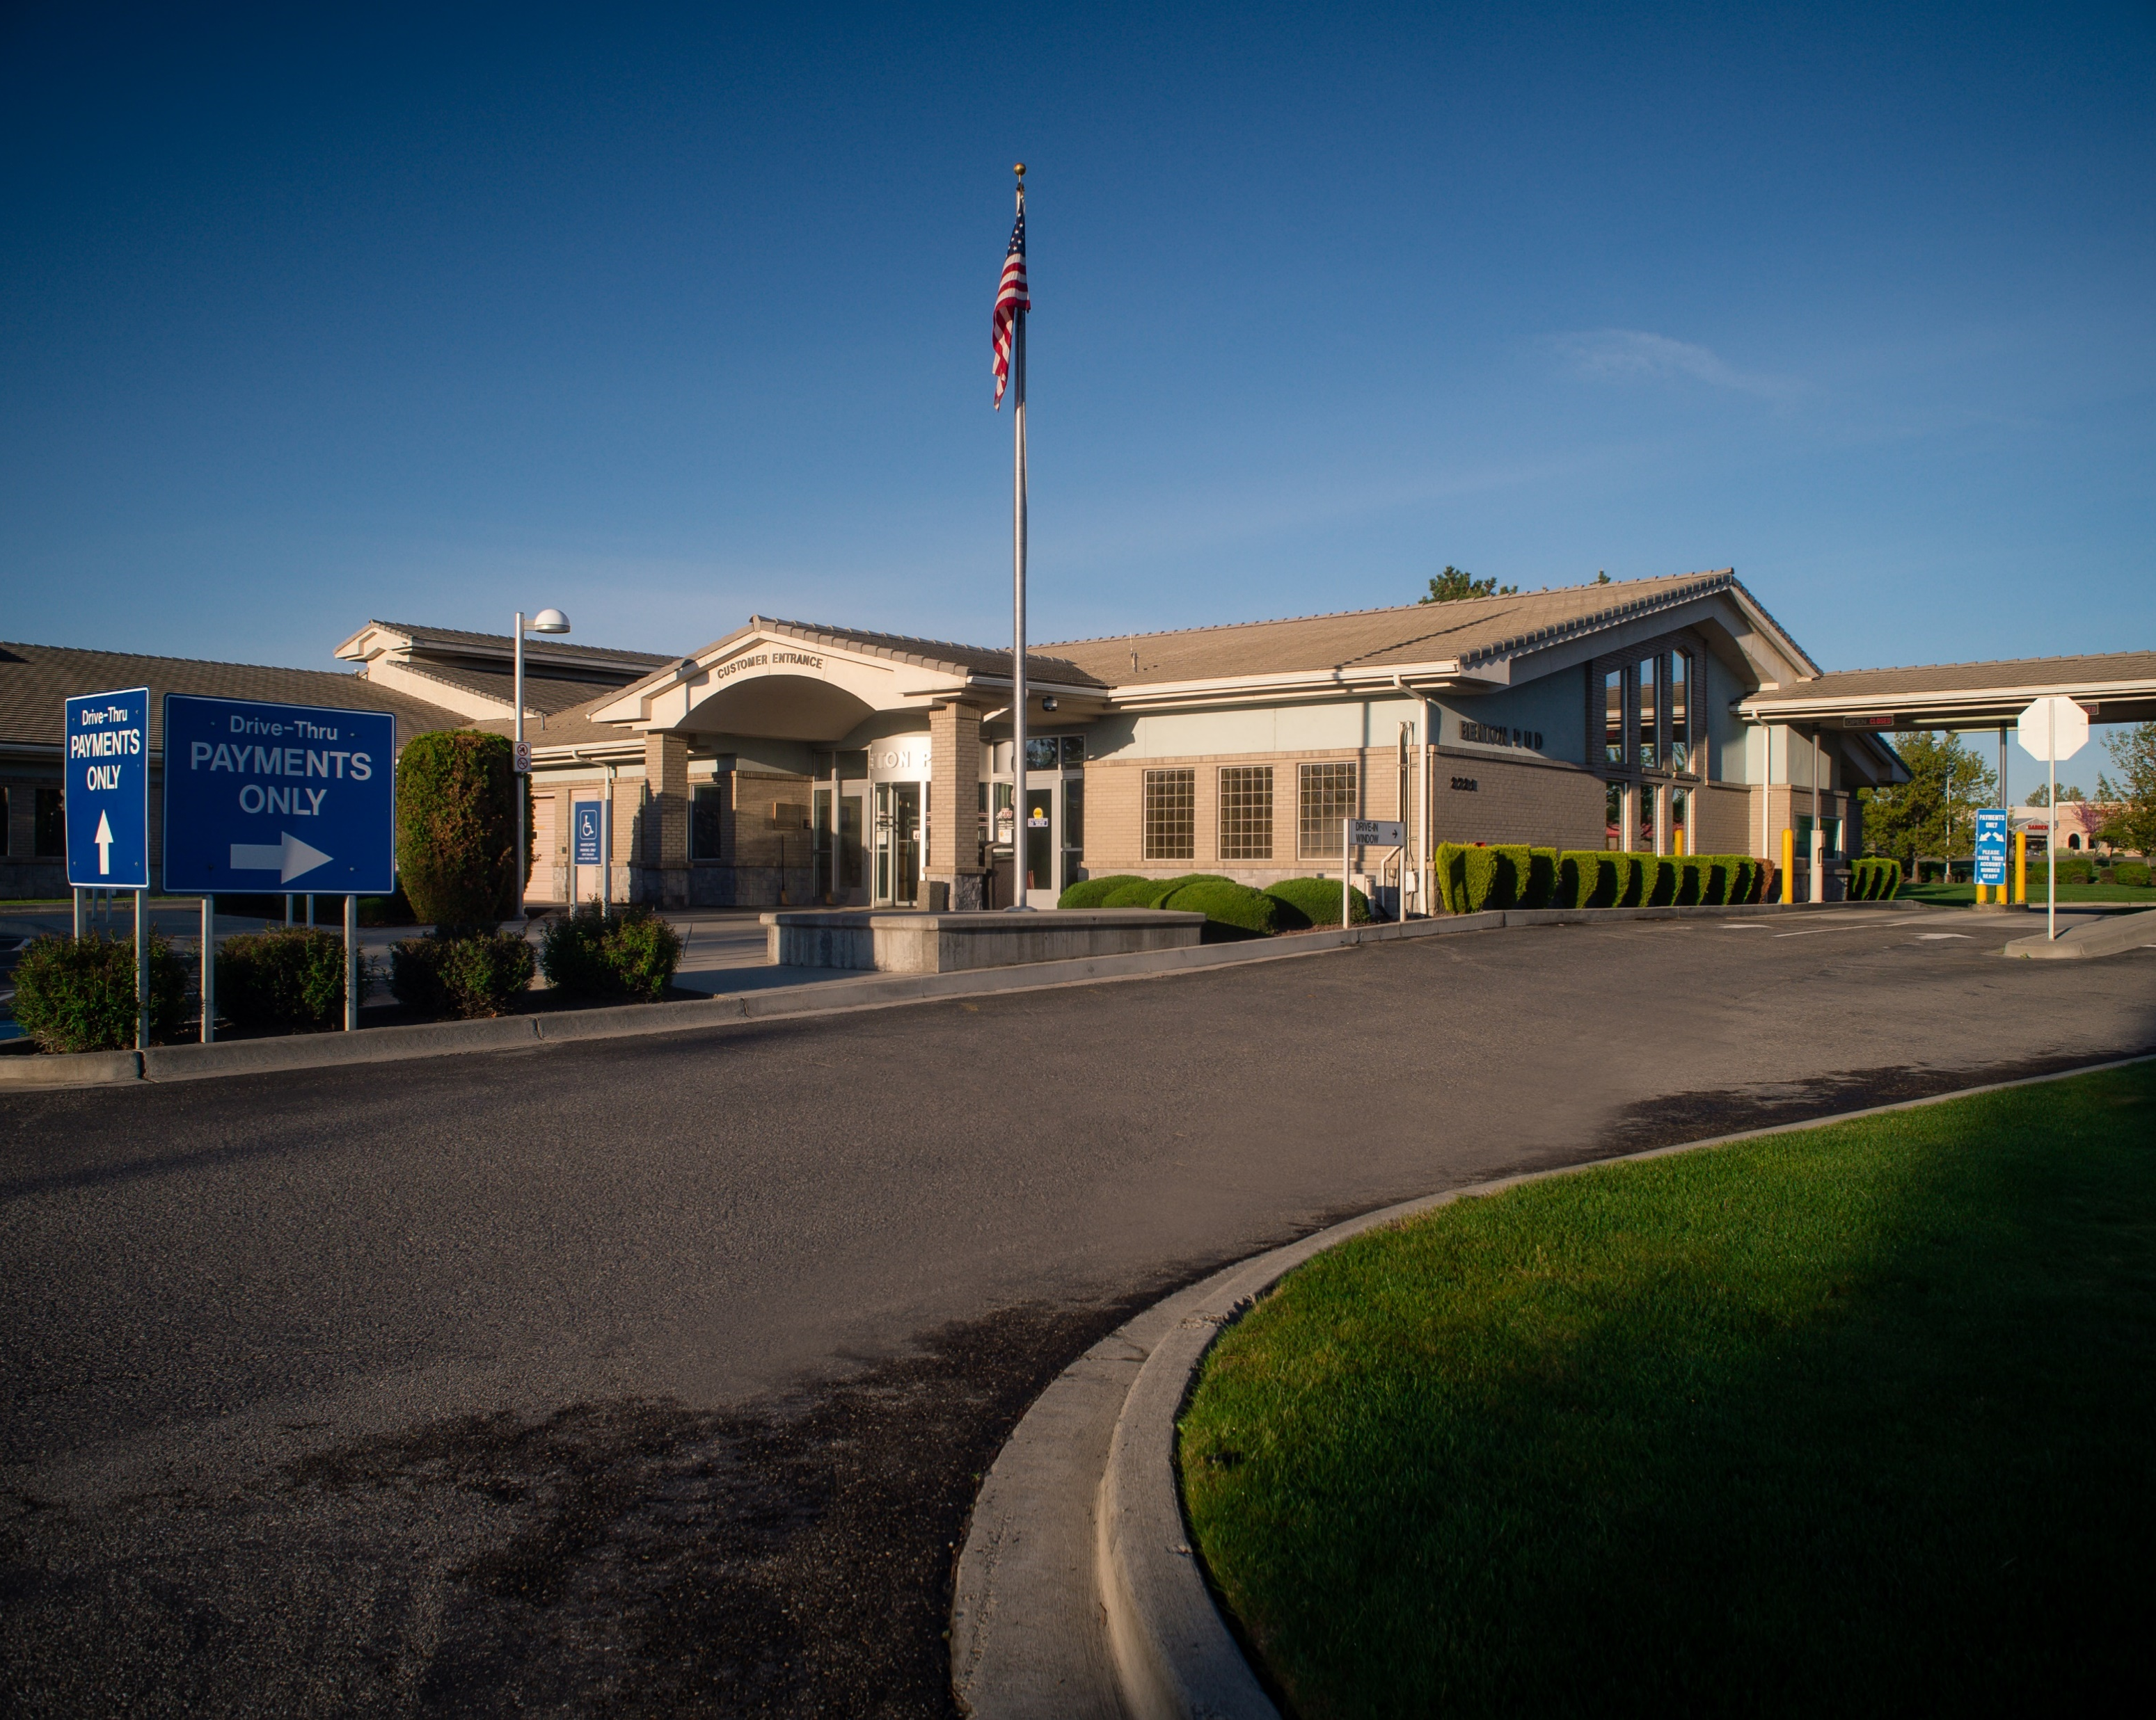
Policy 25J
Vulnerability and Risk Management
Defines how vulnerabilities are identified, assessed, prioritized, and remediated.
Establishes risk-based remediation timelines based on severity and business impact.
Requires documented exceptions and formal risk acceptance when remediation is not feasible.

Slide 9
Policy 25L
Artificial Intelligence
Finalized October 1st
Establishes a District approved general purpose AI environment
Defines acceptable and prohibited use.
Covers other topics such as Intellectual Property, Data Privacy and Security, Records Management, Roles and Responsibilities, Exception Requests

Slide 10
Protection and Detection
Last 90 Days
5,281
Malicious emails blocked
9
Anti-Virus blocks
1,145
Malicious emails removed
635
Security Alerts

Slide 11
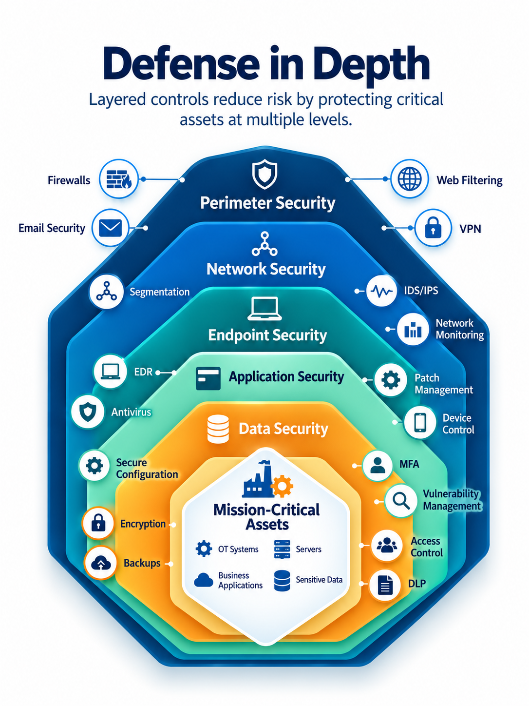
Cybersecurity Defense Measures
Layered Security Approach
Vulnerability and Patch Management
Identity and Access Security
Endpoint and Email Protection
Network and OT Security
Security Monitoring and Threat Detection
Data Protection and Recovery

Slide 12
2027 and Beyond
Strengthening Operational Technology Security
Planned Security Improvements
Security Monitoring – Expand visibility into OT network activity
Vulnerability and Configuration Management – Improve identification and prioritization of security weaknesses

Slide 13
Questions?
Thank you!

