Slide 1
Small Distributed Generation
Interconnection & Net Billing
Commission Information Update
October 27, 2026

Slide 2
What Has Changed Since September 8?
SINCE THEN
OCT 27
SEP 8
NOV
Initial Commission briefing
Documents + Project advance
Information update
Commission rate action
Identified technical, document, rate and governance work.
District document development; Continued coordination with customer;
Share draft application, agreement approach, and Net Billing rate structure.
Staff intends to return with a final recommendation on the Net Billing rate schedule
CURRENT PROJECT STATUS
200 kW AC
BPA coordination
Engineering review
Customer ready
Final proposed Maximum Generating Capacity
Confirmed BPA rules not applicable, when less than or equal to 200 kW AC
Existing Resolution 2259 (Tier 2) provides the technical basis to continue
Customer preparing for procurement and construction;

Slide 3
Generation Capacity Size Thresholds
200 kW AC
PROJECT
25 kW
100 kW
200 kW
500 kW
1 MW
20 MW
SCHEMATIC — THRESHOLDS NOT TO SCALE
WA NET METERING
RCW 80.60
≤ 100 kW
net-metering size limit
BPUD Net Metering Interconnection Standards
Tier 1,
≤ 25 kW
Tier 2,
≤ 100 kW
BPUD Interconnection Standards
Resolution #2259
Tier 1,
≤ 25 kW
Tier 2, < 500 kW,
with screens met
Tier 3, < 20 MW,
project-specific review as applicable
WAC 480-108-020 Provides a similar framework for UTC-regulated utilities but does not govern BPUD.
BPUD PROCESSES
Net Metering / Net Billing
≤ 100 kW,
Net Metering (Existing)
≤ 200 kW,
Net Billing (New)
BPA TRANSMISSION
Small Gen. Procedures
> 0.2 MW to ≤ 20 MW
BPA Small Generator Interconnection Procedures (SGIP), where applicable
BPA POWER
RD → Provider of Choice
Regional Dialogue:
Resources ≤ 200 kW not required to be dedicated
Provider of Choice:
Resource threshold increases to ≤ 1 MW
Different thresholds answer different questions regarding:
Technical interconnection, billing eligibility, BPA transmission processes, and BPA power-supply treatment.
3

Slide 4
A Repeatable Customer-Facing Framework Is Taking Shape
1
Interconnection Application
3
Interconnection Agreement
4
Net Billing Rate Schedule
Defines the project
Defines the obligations
Defines compensation
Project’s “Maximum Generating Capacity”
Approved Interconnection Application becomes ATTACHMENT A
Imports and exports separately metered
Utility’s “Applicable Interconnection Standards”
Retail purchases remain on retail rate
Utility’s Applicable Interconnection Standards become ATTACHMENT B
Excess generation credited at the avoided cost rate
2
Engineering Review
Confirms what is required
Project-specific requirements & costs, if any, become
ATTACHMENT C
Avoided cost rate set by Commission
Review Project Application
Identify project-specific requirements and costs
References the Net Billing Rate Schedule
Avoided cost rate subject to change

Slide 5
Near-Term Path to Move the Project Forward
Complete
technical review
Resolve Remaining
Questions
Commission adopts Net Billing rate schedule
Finalize
customer documents
Confirm the project-specific interconnection requirements.
Review any Interconnection Agreement and net billing questions.
Complete the application and execute the agreement.
Approve the generation credit and net billing implementation.
Today’s emphasis is the near-term path to move this project forward.
Broader document updates may follow later.

Slide 6
BPA Load Following Contract

Slide 7
2027 Gross Power Supply Cost by Source
Gross Power Supply $92.3 million
Description | Amount
BPA Tier 1 Power | $56.7
BPA Tier 1 Load Shaping Charge/(Credit) | 0.6
BPA Tier 2 Power | 6.9
BPA Demand | 4.6
BPA Preliminary Injunction (BP-27) | 5.4
BPA Transmission | 11.1
Renewables & Other | 5.0
Ancillary | 1.6
Net Conservation | 0.4
Gross Power Supply | $92.3
Less: Secondary Market Sales | (1.5)
Less: Transmission Sales | (0.1)
Net Power Expense | $90.7
Dollars in millions

Slide 8
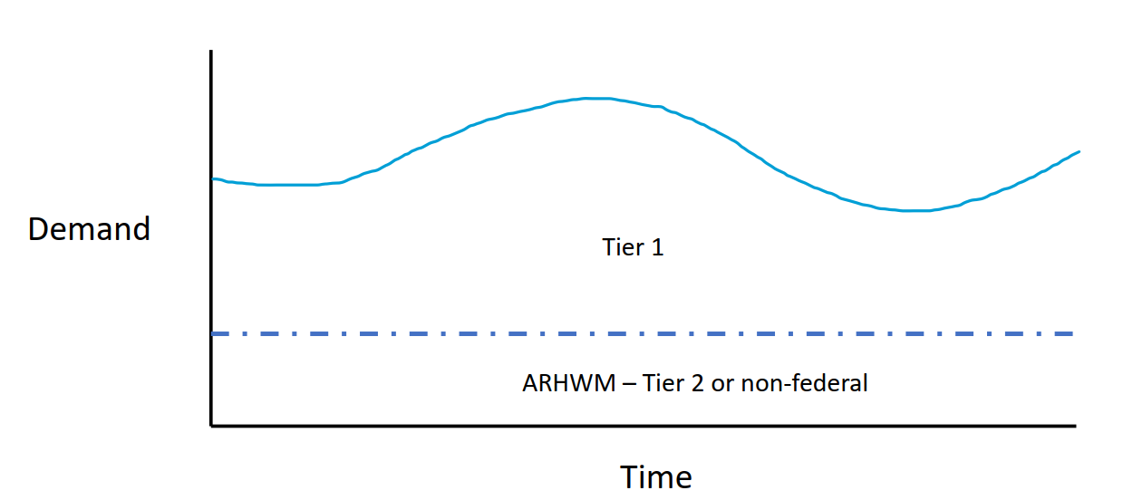
BPA Rates: Tier 1 v. Tier 2
Follows Load
Above CHWM =
Flat Block

Slide 9
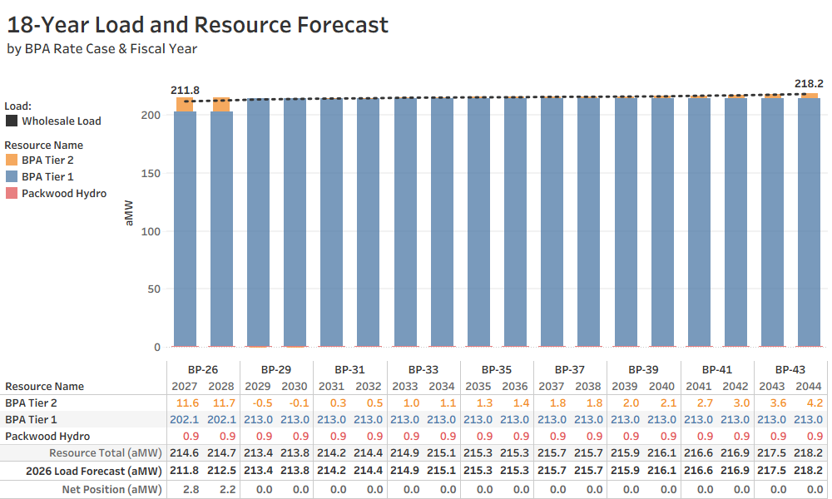
Benton PUD’s Resource Plan
BPA Tier 1 CHWM increases to 213.007 aMW effective 10/1/2028
16-Year Provider of Choice Contract

Slide 10
BPA Rates: Tier 1 v. Tier 2
Tier 2 Rate
  Forecast Net Requirement above CHWM Fixed Cost for BPA Rate Period
  Fixed also referred to as “Take-or-Pay”
Tier 1 Rate
  Tier 1 Composite/Non-Slice Rate Fixed Cost for BPA Rate Period
    Based on lower of Contract High Water Mark (CHWM) or Forecast Net Requirement
  Load Shaping Rate Variable Cost during BPA Rate Period
    This rate “trues-up” actual load to forecast load during a BPA rate period
    ~$40/MWh on average

Slide 11
BPA Rates: Tier 1 v. Tier 2
Rate Case
BP-24
BP-26
BP-29
Fiscal Year
2024
2025
2026
2027
2028
2029
2030
Forecast Net Requirement Finalized For BP-26
Forecast Net Requirement Finalized For BP-29

Slide 12
BPA Rates: BP-26 Tier 1 v. Tier 2
BPUD gets 2.842% of Tier 1 power (Tier 1 Costs Allocator or TOCA). ~$35/MWh
Once a BPA rate case is final, we know with precision how much we will pay for Tier 1 and Tier 2 every month of the rate case
Determined each Rate Case based on BPUD Load Forecast
Tier 2 = TRL – Tier 1 – Packwood. This amount is set for each Rate Case. ~$70/MWh
*Packwood is a dedicated resource at .92 aMW
Notes:
Note: RPS has a cost cap
Per BPA Website the Tier 1 average rate is $37.77, but Benton PUD’s rate is $35.00 per the Rate Impact Model

Slide 13
Load Shaping
Intended to charge or credit a customer based on how loads align with Tier 1 firm capability
BPA publishes monthly HLH and LLH load shaping rates in each rate case
  Based on forward market monthly amounts (separate process from Tier 2)
Load shaping also trues-up the difference from Tier 1 & Tier 2 “Take or Pay” rates established by forecast to actual load
The Load Shaping rate is Benton PUD’s marginal cost of energy during a BPA rate period

Slide 14
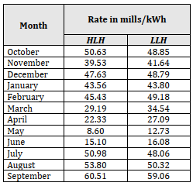
Load Shaping Cost Example HLH
BPA Load Shaping Rates by Month
~$40/MWh average
Notes:
BP-26 Load Shaping rates
Oct & Apr ID’d as constraints in BPA Resource Study

Slide 15
Load Shaping Cost Example HLH
Total HLH Load Shaping = $(1,592,068)
BPA Load Shaping Rates by Month
~$40/MWh average
Notes:
BP-26 Load Shaping rates
Oct & Apr ID’d as constraints in BPA Resource Study

Slide 16
Load Shaping Cost Example HLH
Increase Load 5 aMW
Total HLH Load Shaping = $(575,147)
BPA Load Shaping Rates by Month
~$40/MWh average
Notes:
BP-26 Load Shaping rates
Oct & Apr ID’d as constraints in BPA Resource Study

Slide 17
Load Shaping Cost Example HLH
Decrease Load 5 aMW
Total HLH Load Shaping = $(2,608,987)
BPA Load Shaping Rates by Month
~$40/MWh average
Notes:
BP-26 Load Shaping rates
Oct & Apr ID’d as constraints in BPA Resource Study

Slide 18
Avoided Cost
If BPA Tier 1 Composite & Tier 2 are “take or pay”; and
Benton PUD’s Tier 2 exposure is ZERO for BP-29,
What is the avoided energy cost to Benton PUD from customer owned distributed generation?
  BPA’s Load Shaping rate
If Benton PUD had Tier 2 exposure for BP-29, what is the avoided energy cost?
  Mostly BPA’s Tier 2 rate, with some Load Shaping

Slide 19
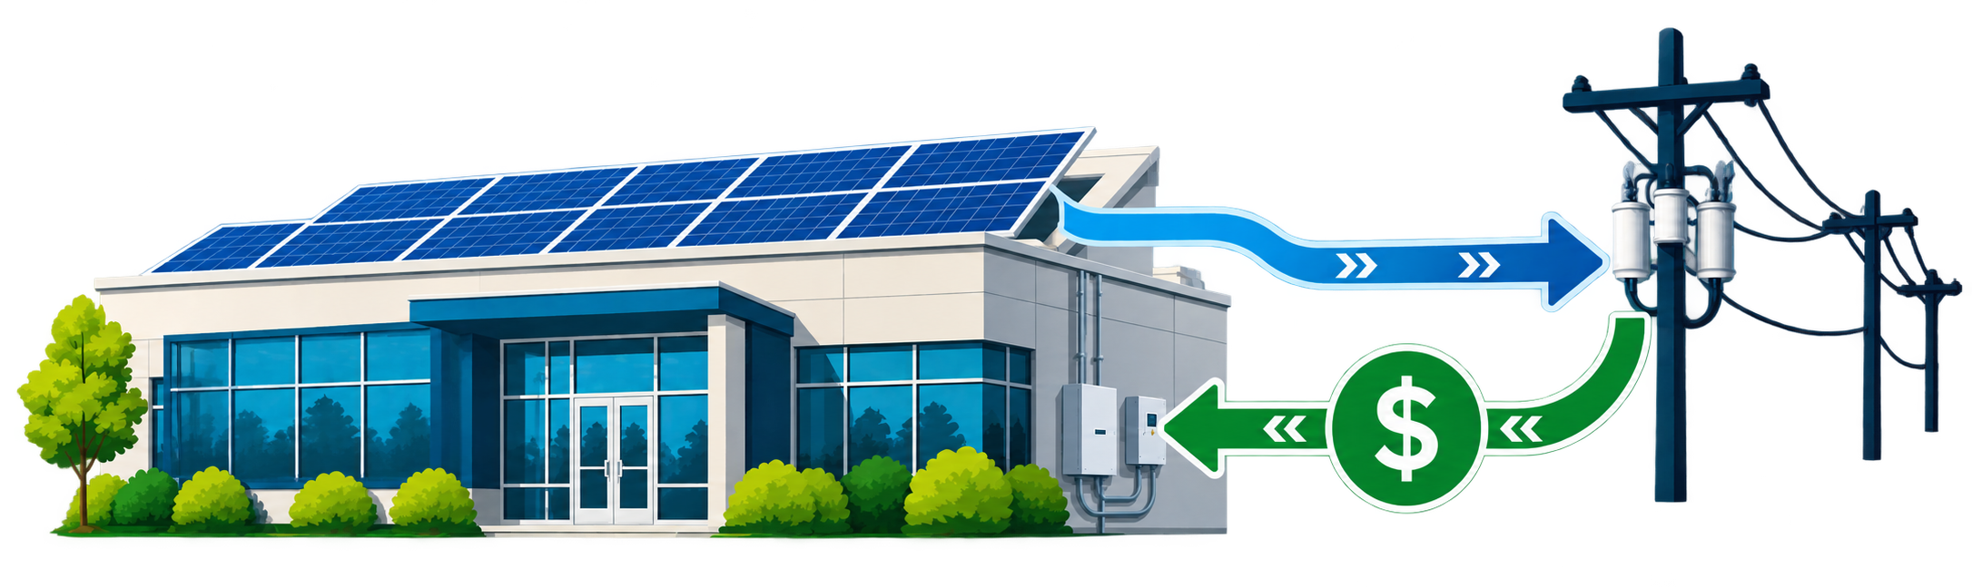
Net Billing & Avoided Cost Credit Development

Slide 20
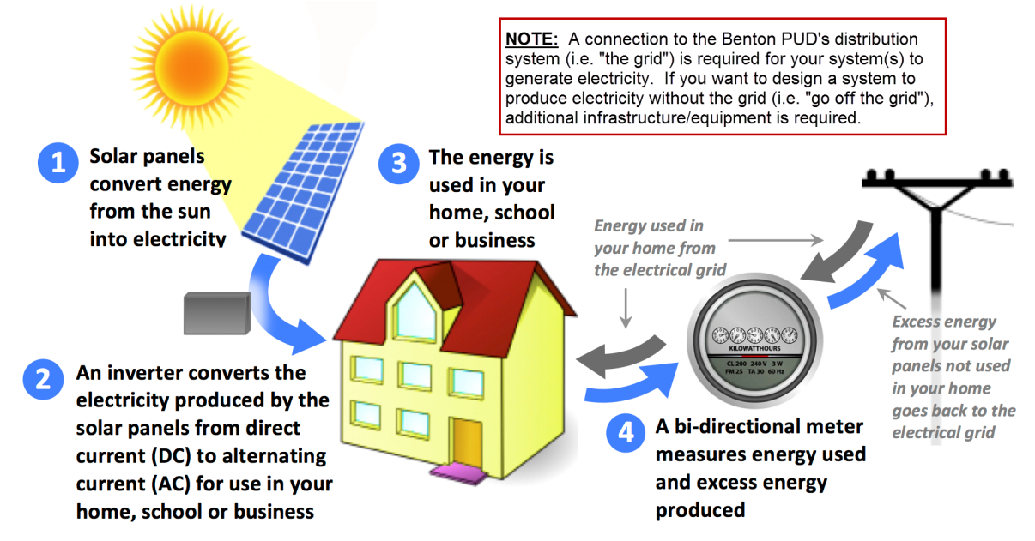
How Net Billing Would Work
KEY POINT | Imported and exported energy are measured separately; only exports receive the avoided-cost credit
3. Customer uses solar power
Solar generation consumed on-site reduces energy purchased from
Benton PUD.
IMPORTS from Benton PUD
EXPORTS to Benton PUD
Customer purchases all energy physically flowing from Benton PUD under the applicable retail rate schedule (e.g., Medium General Service).
Excess generation receives a bill credit under a separately published, Commission-approved, Net Billing rate schedule (e.g. avoided cost)

Slide 21

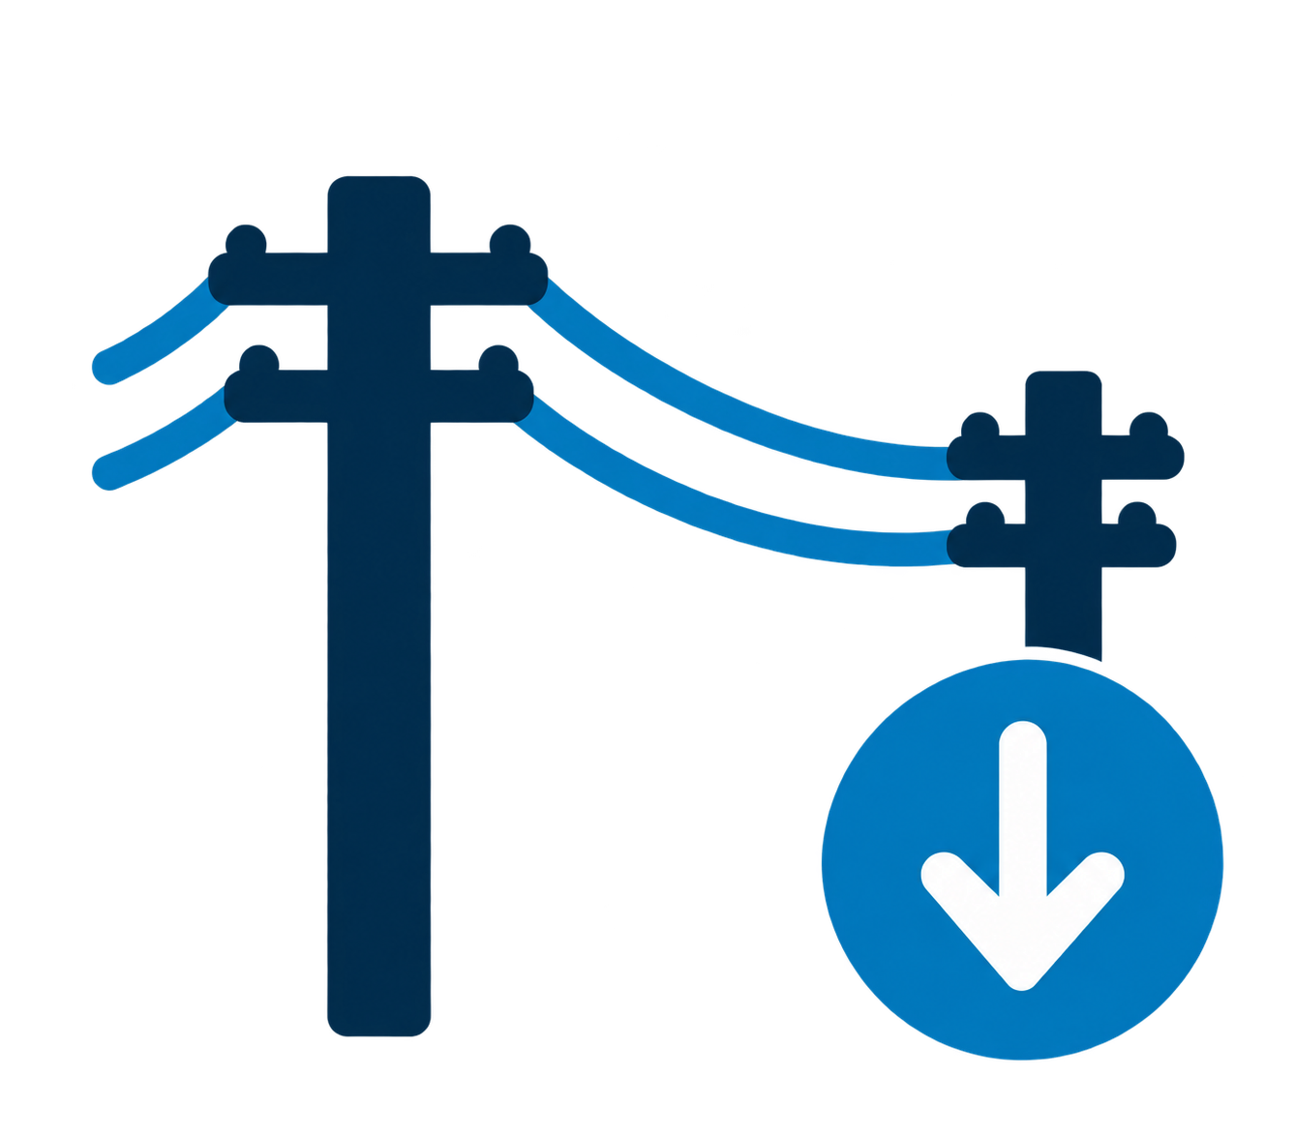



Proposed Avoided-Cost Credit
3.7166¢
per kWh
0.1267¢
per kWh
0.1919¢
per kWh
Avoided BPA Energy
Load Shaping Rates
Avoided Benton PUD
Transmission & Distribution
Losses
Avoided Renewable
Energy Certificate Purchases
4.0352¢ per kWh

Slide 22

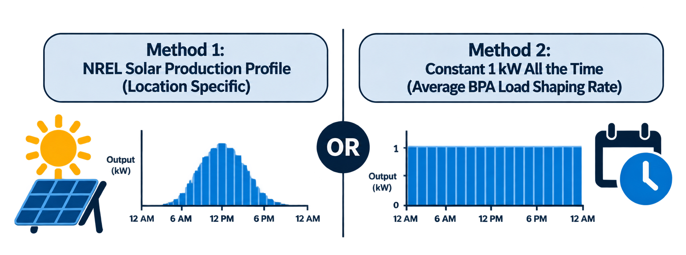
How Staff Developed the Avoided BPA Load Shaping Rate
Method
NREL Solar Production Profile
(Kennewick, WA)
3.7166¢
per kWh
Avoided BPA Energy
Load Shaping Rates
Used NREL’s PVWatts calculator to develop an hourly solar production profile for our service territory and apply BPA’s hourly load shaping rates to calculate the avoided cost.
Notes:
3.9388¢ if we wanted to use the average load shaping charge

Slide 23
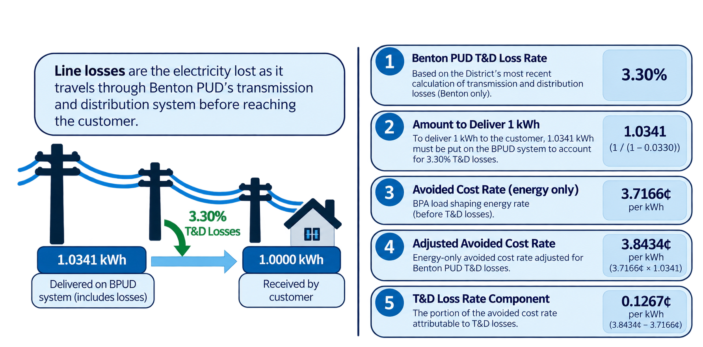
How Staff Developed the Benton PUD T&D Loss Rate
Line losses are the electricity lost as it travels through Benton PUD’s transmission and distribution system before reaching the customer.
0.1267¢
per kWh
Avoided Benton PUD
T & D Losses
Notes:
Benton PUD's Transmission and Distribution (T&D) loss rate calculation estimates the additional electricity the District must purchase to account for energy lost as it travels through its electrical system before reaching customers.
By generating electricity locally, customers can reduce the amount of electricity that would otherwise need to travel through Benton PUD's system, avoiding some of those losses.
Step 1: Determine Benton PUD's T&D loss percentage
Based on the District's historical loss calculations, staff used a 10-year average T&D loss rate of 3.30%.
This means that for every 100 kWh entering the District's distribution system, approximately 96.7 kWh reaches customers.
Step 2: Calculate the electricity required to deliver 1 kWh
Because some electricity is lost during delivery, Benton PUD must purchase more than 1 kWh to deliver 1 kWh to a customer.
Step 3: Adjust the avoided energy cost
Staff calculated an avoided BPA energy cost of 3.7166¢ per kWh.
To account for Benton PUD's T&D losses, multiply this rate by the amount of electricity required to deliver 1 kWh.
Step 4: Calculate the avoided T&D loss component
Subtract the original avoided energy rate from the adjusted rate.

Slide 24
How Staff Developed the Avoided REC Purchase Rate
1
Select REC Contract
Use the most recent contract reflecting the current REC market (3 Degrees – 2026).
$12.79
per REC
2
Apply EIA Requirement
Multiply the selected REC price by the 15% EIA requirement.
$12.79
×
15%
=
$1.9185
per REC
per MWh
0.1919¢
per kWh
3
Convert to ¢/kWh
Divide $/MWh by 10 to convert to cents per kWh.
Avoided
REC Purchases
$1.9185
÷
10
=
0.1919¢
per MWh
per kWh
Notes:
The reason Benton PUD multiplies the cost per Renewable Energy Certificate (REC) by the Energy Independence Act (EIA) requirement of 15% is that the District does not need to purchase one REC for every MWh of electricity it sells. It only needs enough qualifying renewable energy or RECs to satisfy its 15% renewable energy requirement.

Slide 25

Draft Schedule 91: Net Billing for Small Distributed Generation
Key Takeaways
Eligibility
Net Billing
Generation greater than 100 kW AC and not more than 200 kW AC; on customer premises with an executed interconnection agreement.
Retail charges apply to electricity received from Benton PUD. Excess electricity exported to the District earns a separate credit.
Generation Credit
Monthly Credits
4.04¢/kWh for energy delivered to the District. Rate Schedule requires a review of the avoided-cost rate for each BPA rate period.
Generation credits apply after retail charges are calculated. Unused monetary credits carry forward to future bills.
Annual Settlement – March 31
Balances of $500 or more: customer may request payment or carry forward. Balances below $500: automatically carry forward.
Customer self-consumption reduces retail purchases but does not earn a separate generation credit.

Slide 26

Next Steps
October 27, 2026
Information & Discussion
Presented proposed Schedule 91 concepts and avoided cost methodology; receive Commission feedback
November 2026
Commission Approval
Staff returns with final Schedule 91
and a resolution for Commission consideration
Project Execution
Interconnection Agreement
Complete the project interconnection application and execute the agreement
No Commission action requested today

Slide 27


Other Avoided Cost Components Evaluated
BPA Tier 2
Demand & Capacity
Excluded currently – Existing power commitments and anticipated Tier 1 headroom limit incremental savings from customer generation
Excluded – Net billing already allows customers to reduce retail demand charges. Additional capacity savings were not established.
BPA Rate Adjustments
Transmission & Infrastructure
Excluded – COORA, FRP, CRAC, and RDC are generally based on fixed billing determinants rather than actual loads.
Excluded – Non demonstrated reduction in BPA transmission billing demand or deferral of specific capital projects.
Other Potential Avoided Costs
Social cost of carbon, risk adders, ancillary services and resource adequacy were evaluated but excluded because they do not represent separately identifiable, directly avoided District costs under this methodology.
Guiding Principle: Include only costs that reduce Benton PUD’s actual expenses when
customer generation is delivered to the District, while avoiding double compensation.

Slide 28
How Staff Developed the Benton PUD T&D Loss Rate
Notes:
This slide is deliberately conceptual. Jon can first explain how BPA billing works, then use these categories to explain why an avoided-cost credit is different from both the retail rate and a wholesale market price. Components remain subject to analysis.
[Sources]
• Draft Retail Electric Rate Schedules Attachment Use this one (no EIL rates).docx — working Schedule 91
• Benton PUD internal Net Billing design discussion; current BPA Load Following / power-supply context

Slide 29
How Staff Developed the Avoided BPA Load Shaping Rate
3.7166¢
3.9388¢
Use NREL’s PVWatts calculator to develop an hourly solar production profile for our service territory and apply BPA’s hourly load shaping rates to calculate the avoided cost.
Assume 1 kW of generation in every hour and apply BPA’s hourly load shaping rates to calculate the avoided cost.
Notes:
This slide is deliberately conceptual. Jon can first explain how BPA billing works, then use these categories to explain why an avoided-cost credit is different from both the retail rate and a wholesale market price. Components remain subject to analysis.
[Sources]
• Draft Retail Electric Rate Schedules Attachment Use this one (no EIL rates).docx — working Schedule 91
• Benton PUD internal Net Billing design discussion; current BPA Load Following / power-supply context

Slide 30
Load Shaping Cost Example LLH
Total LLH Load Shaping = $2,574,941

